Slide 1
Team 05 Augmented Reality Project TCSP #03
Stephen Carlson, Steven Ellis, Alec Stephen Green, Thor Smith

Slide 2
Abstract
A multiuser augmented reality system with one or more headsets communicating via a central control unit, intended primarily for games but with other applications possible

Slide 3
Block Diagram
Headset
CCU
9DOF
Xbee
Xbee
micro
micro
GPS
Raspberry Pi
Raspberry Pi
LCD

Slide 4
PSSC
An ability to render graphics based on the orientation of the user’s head.
An ability to render graphics based on the user’s current geospatial location.
An ability to monitor and display the battery power level of the headset to the user.
An ability to monitor and display the status and quality of the wireless connection to the central control unit.
An ability to load headset graphics for a new simulation without re-flashing software on the headset’s microcontroller.

Slide 5
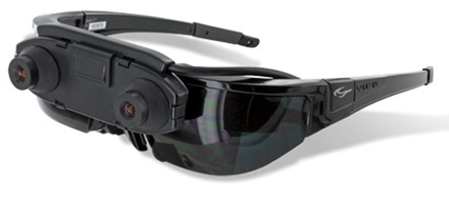
Vuzix 1200AR
Opaque display takes up entire field of view
Uses two front mounted cameras for overlay

Slide 6
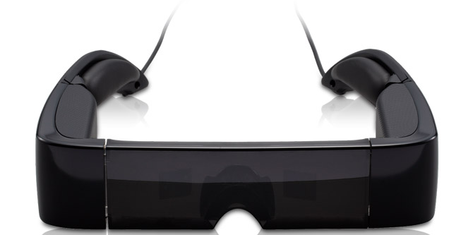
Epson BT-100
Transparent display using beam splitters

Slide 7
Comparison
Beamsplitter | Camera
- Narrow field of view | + Wider field of view
- Unable to focus on display and background simultaneously | + Can focus on display and background simultaneously
- Poor visibility in bright ambient light | + Visibility not impacted by ambient light
- More complicated/fragile construction | + Easier to build
+ Retains peripheral vision | - No peripheral vision
+ Uses no CPU/GPU | - Uses more processing resources
+ Uses no power | - Added power consumption
+ Retains normal vision | - Loses depth cues/resolution on background

Slide 8
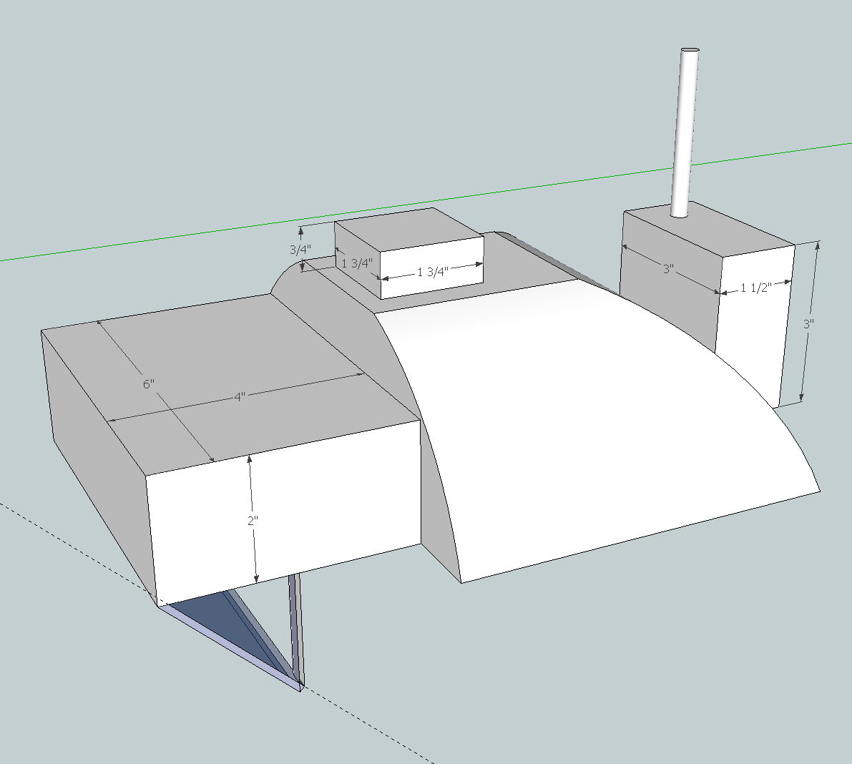

Slide 9
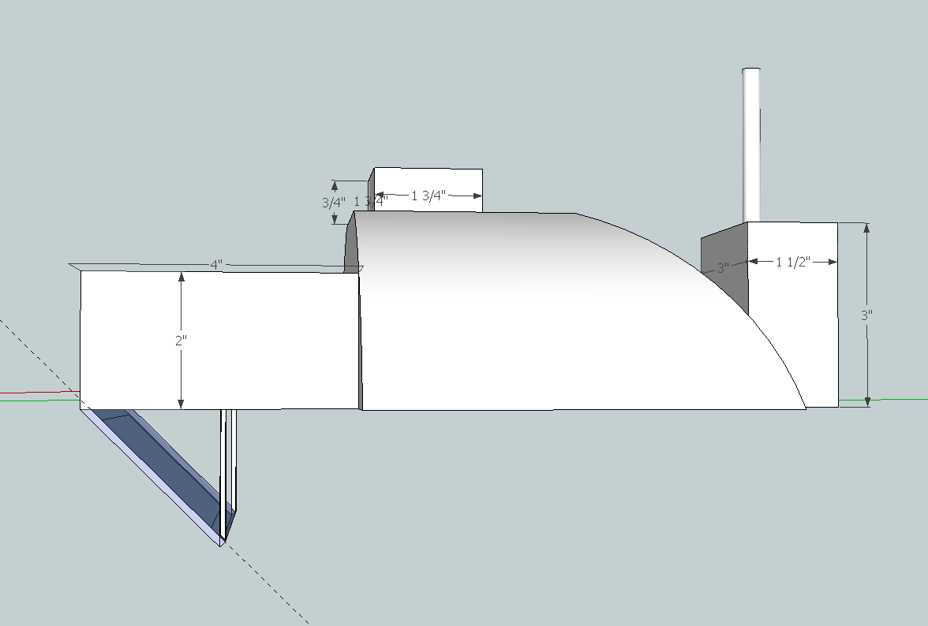

Slide 10
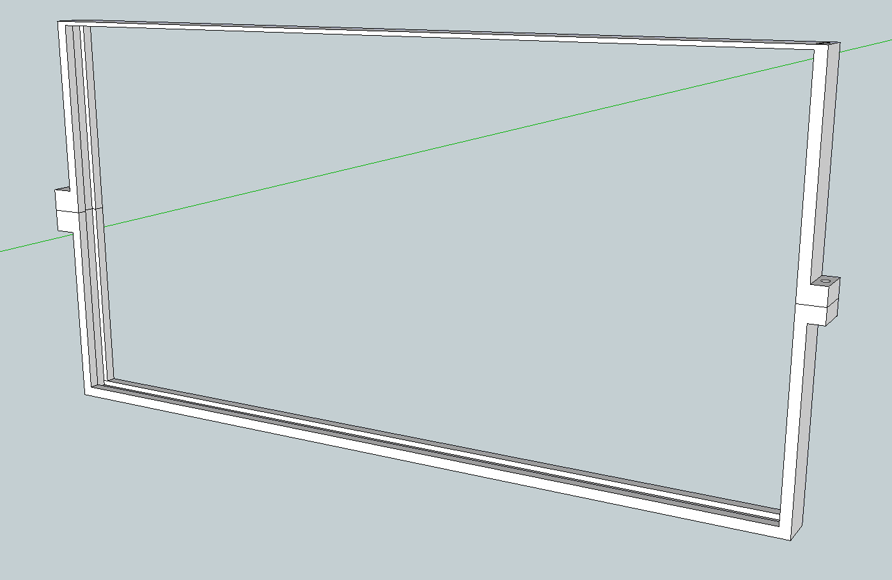

Slide 11
Materials and Tools
Hat/helmet
Boxes for display, PCB/battery stack
Beamsplitter glass
needs specialized cutting tools
Frame for glass
3d printed

